Slide 1
HEART DISEASE DIAGNOSTIC ANALYSIS

Slide 2
INTRODUCTION
Heart disease remains a significant global health concern, affecting millions annually. Understanding the factors contributing to heart disease and predicting its occurrence are pivotal in effective diagnosis and prevention strategies. In this analysis, we leverage exploratory data analysis (EDA) techniques using Python to gain insights into the underlying trends and correlations within heart disease datasets.
EDA serves as the foundation of our investigation, allowing us to delve into the intricacies of various health parameters and their interrelationships. Through visualizations and statistical summaries, we explore demographic attributes, clinical measurements, and lifestyle factors to discern patterns that may influence heart disease incidence.
The primary objective of this analysis is to uncover key insights that can aid in understanding the risk factors associated with heart disease. By examining correlations and distributions within our dataset, we aim to identify significant predictors and potential avenues for further research and intervention.
Using Python's data manipulation and visualization libraries, including Pandas, NumPy, and Seaborn, we preprocess and analyze the dataset. We employ statistical measures, such as correlation matrices and distribution plots, to highlight critical variables and relationships impacting heart disease diagnosis.

Slide 3
Details of Data
age: Age of the patient in years.
sex: Gender of the patient (1 = male, 0 = female).
chest pain type: Type of chest pain experienced by the patient (1 = typical angina, 2 = atypical angina, 3 = non- anginal pain, 4 = asymptomatic).
resting blood pressure: Resting blood pressure in mm Hg on admission to the hospital.
serum cholestoral: Serum cholesterol in mg/dl.
fasting blood sugar: Fasting blood sugar > 120 mg/dl (1 = true, 0 = false).
resting electrocardiographic results: Resting electrocardiographic results (0 = normal, 1 = having ST-T wave abnormality, 2 = showing probable or definite left ventricular hypertrophy).
maximum heart rate achieved: Maximum heart rate achieved during exercise.
exercise induced angina: Exercise-induced angina (1 = yes, 0 = no).
oldpeak: ST depression induced by exercise relative to rest.
slope: Slope of the peak exercise ST segment (1 = upsloping, 2 = flat, 3 = downsloping).
number of major vessels: Number of major vessels colored by fluoroscopy (0-3).
thal: Thalassemia (0 = normal, 1 = fixed defect, 2 = reversible defect).

Slide 4
Main KPIs
Average Age: Average age of patients in the dataset.
Gender Distribution: Distribution of male and female patients.
Chest Pain Types: Distribution of chest pain types:
Typical angina
Atypical angina
Non-anginal pain
Asymptomatic
Exercise Induced Angina: Percentage of patients with exercise-induced angina.
Fasting Blood Sugar: Percentage of patients with fasting blood sugar > 120 mg/dl.

Slide 5
Population Percentage with Heart Disease: Percentage of individuals diagnosed with heart disease.
ST Depression (Old peak): Average ST depression induced by exercise relative to rest.
Resting Blood Pressure: Average resting blood pressure.
Serum Cholesterol Level: Average serum cholesterol level in mg/dl.
THALASSEMIA: Thalassemia (0 = normal, 1 = fixed defect, 2 = reversible defect)

Slide 6
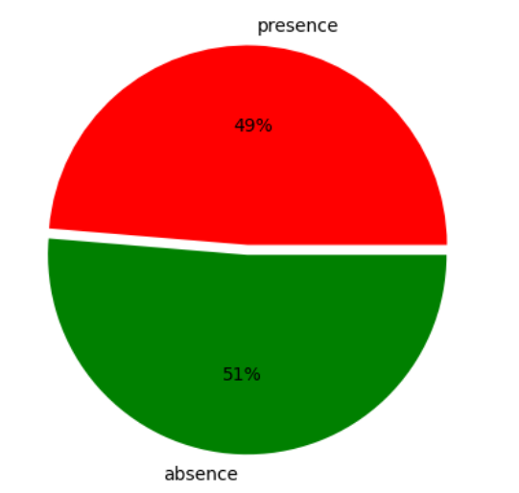
Percentage of People having Heart Disease
The people having heart disease (49%) is lesser than the people not having heart disease (51%)

Slide 7
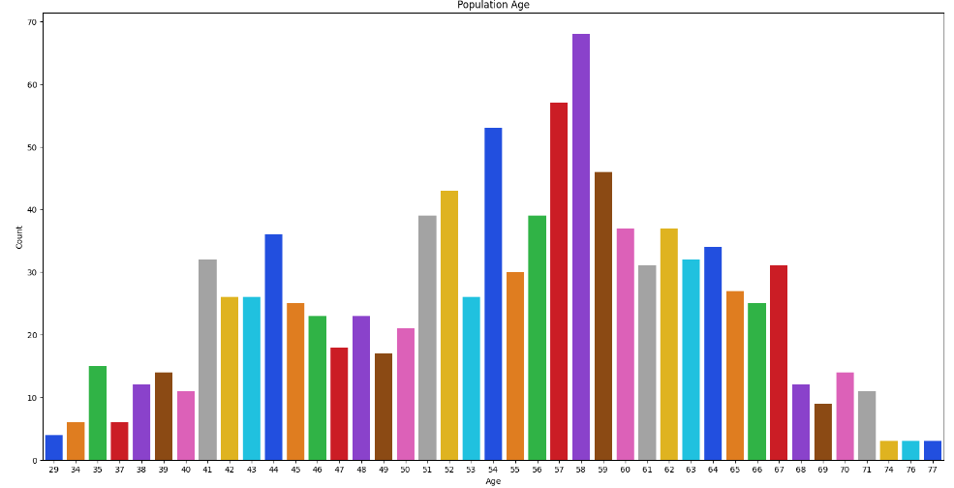
Population based on their Age
From bar chart we can observe that count of population age wise i.e young, middle-age and elder people

Slide 8
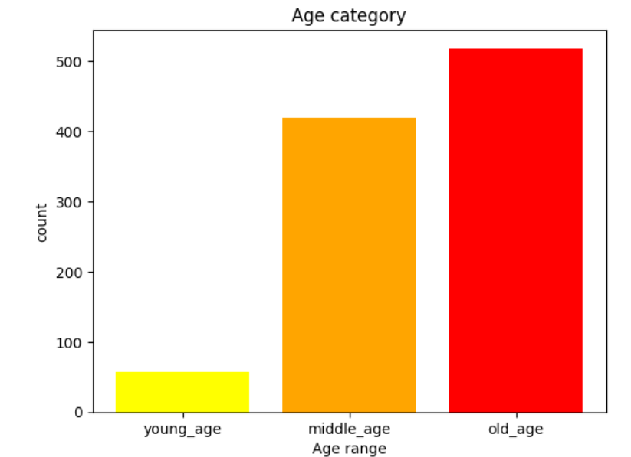
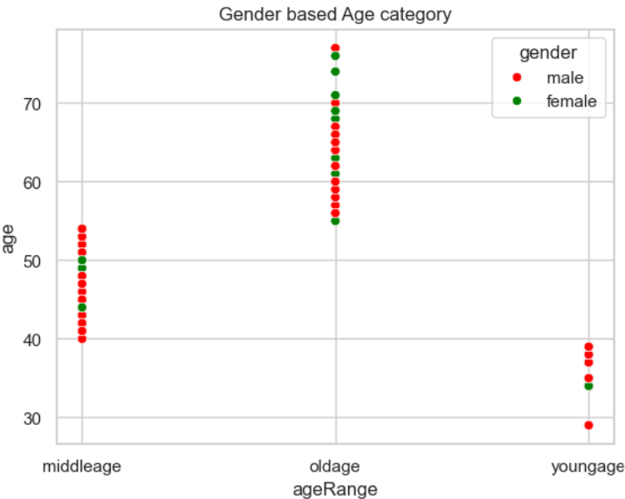
Age Category
Old age population is more than middle age range and young age population is the least
Number of male population is more than the female population in each age group

Slide 9
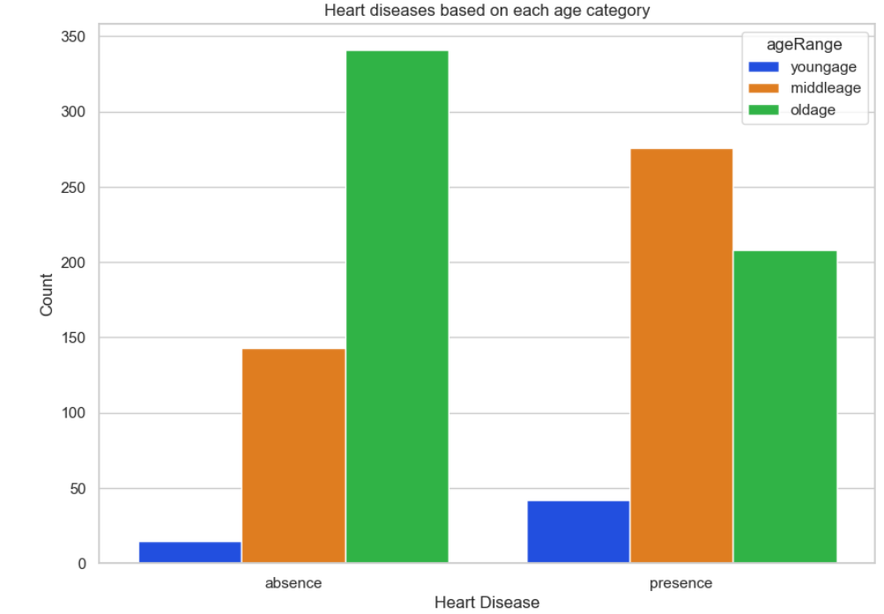
Which age category of people are affected by Heart Disease mostly ?
Middle age people are most affected followed by old age people and young age people are least affected

Slide 10
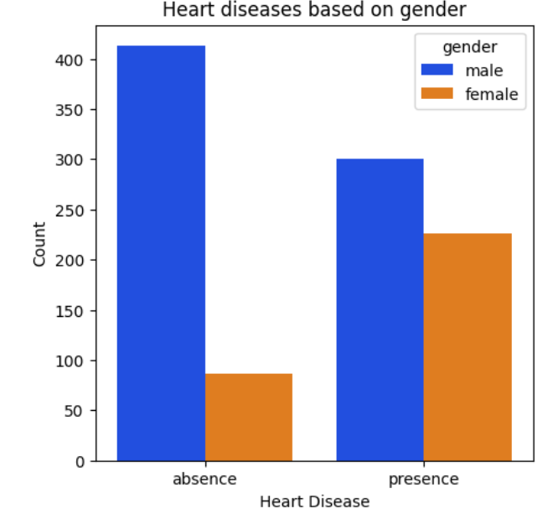
Heart Disease based on Gender
More number of males are affected with heart disease compared to females

Slide 11
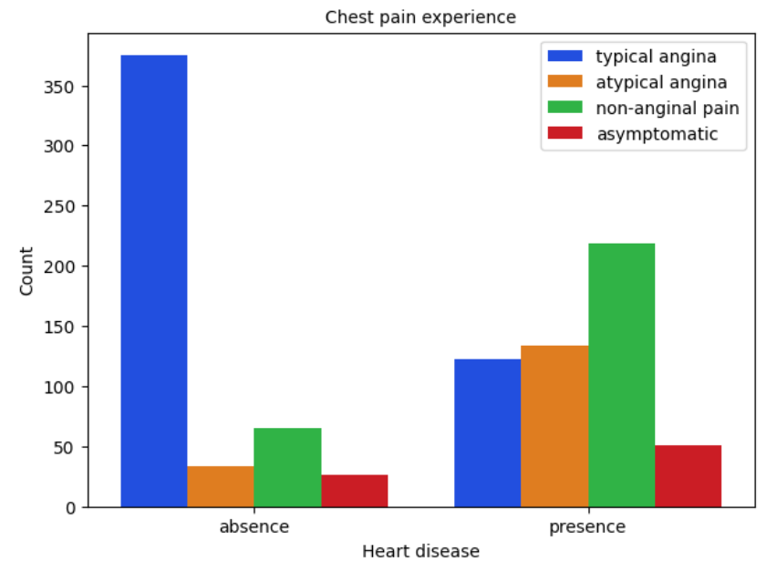
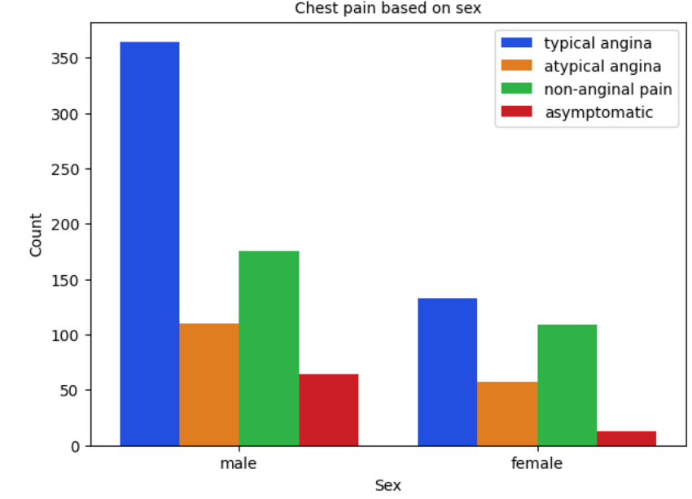
Chest Pain
It seems people having Non-Anginal chest pain have a higher chance of heart disease
We can see that a higher number of males are suffering from Typical Angina type of Chest Pain

Slide 12
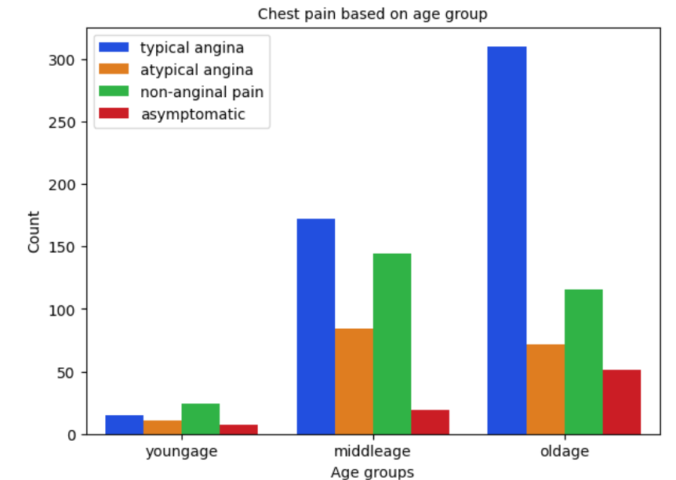
Chest Pain based on Age groups
It is seen that old age people are suffering the most with typical angina chest pain

Slide 13
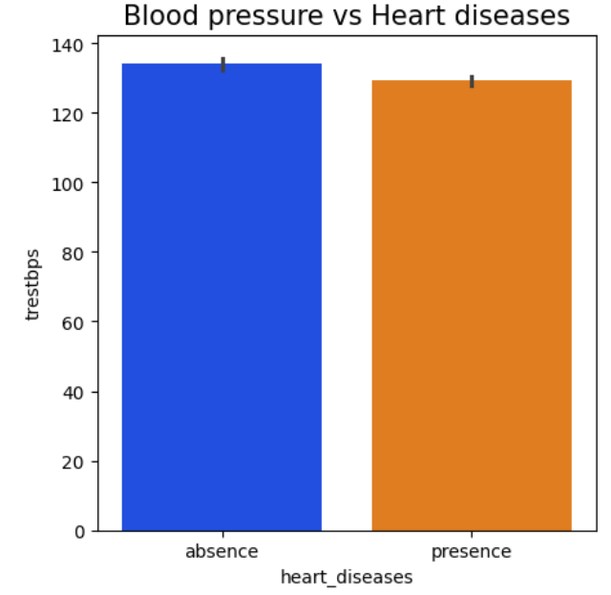
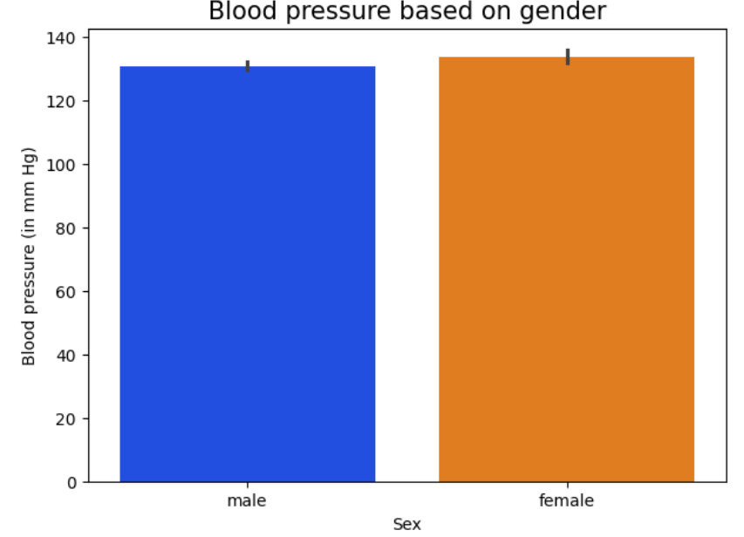
Blood Pressure
It can be observed that Resting Blood Pressure is almost the same for males & females
High levels of blood pressure can cause higher chances of heart diseases

Slide 14
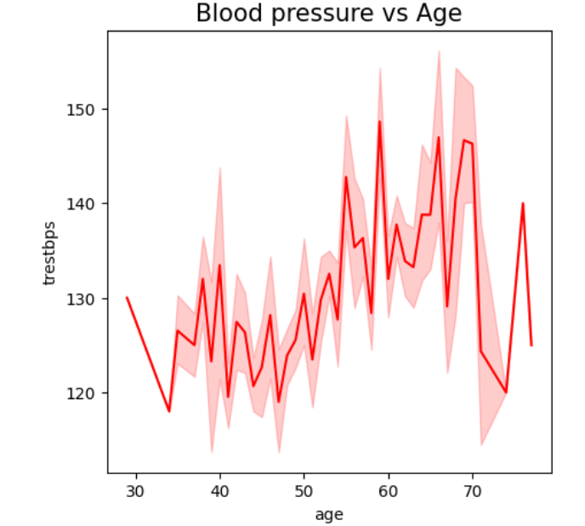
Blood Pressure
It can be seen that blood pressure is normal from age 30 to 50, from 50 to 60 there is increase in blood pressure gradually and after age 60 it can be noted that it is fluctating drastically until age 70

Slide 15
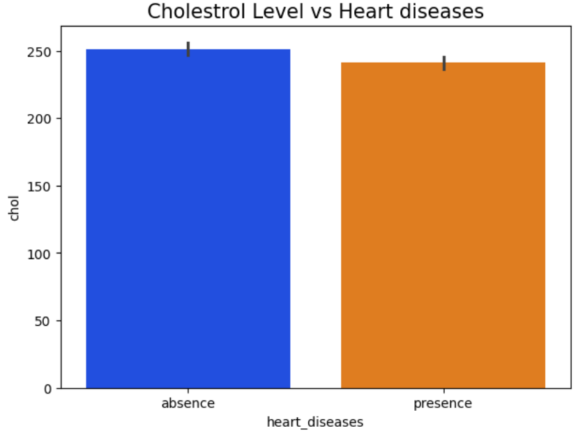
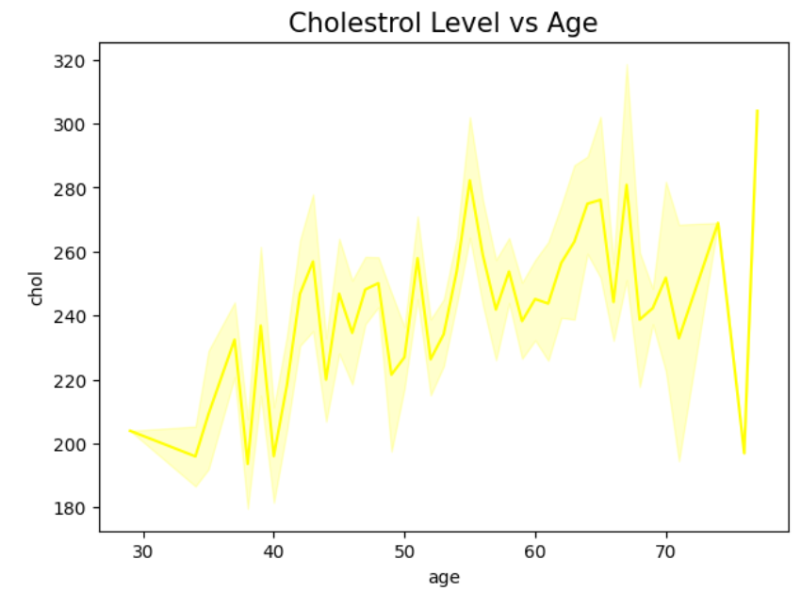
Cholesterol
High levels of cholesterol causes major chances of heart diseases
It can be observed that cholestrol level started increasing after age 50

Slide 16
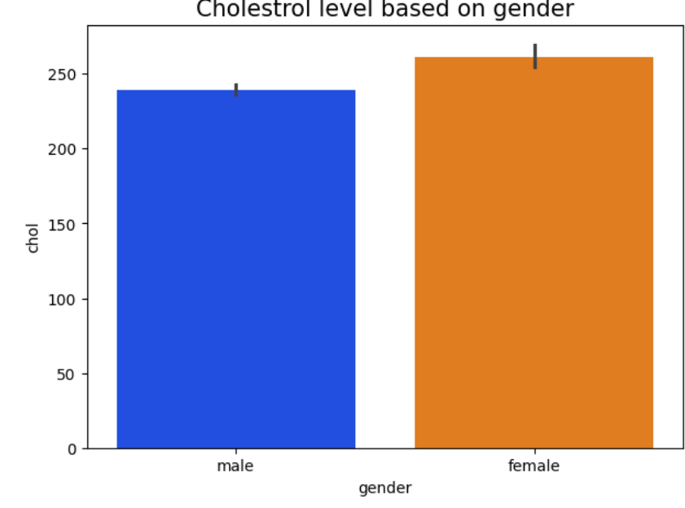
Cholesterol level is slightly elevated in females compared to male

Slide 17
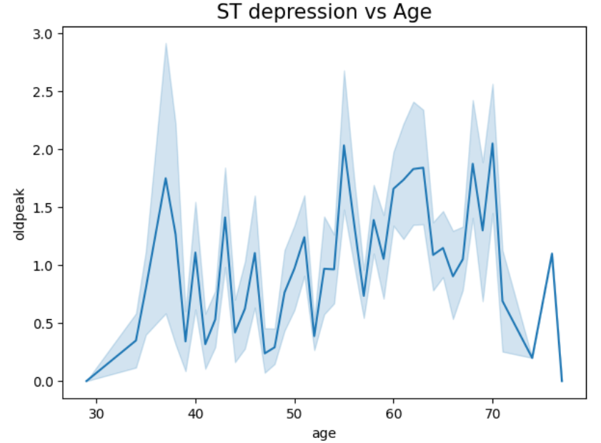
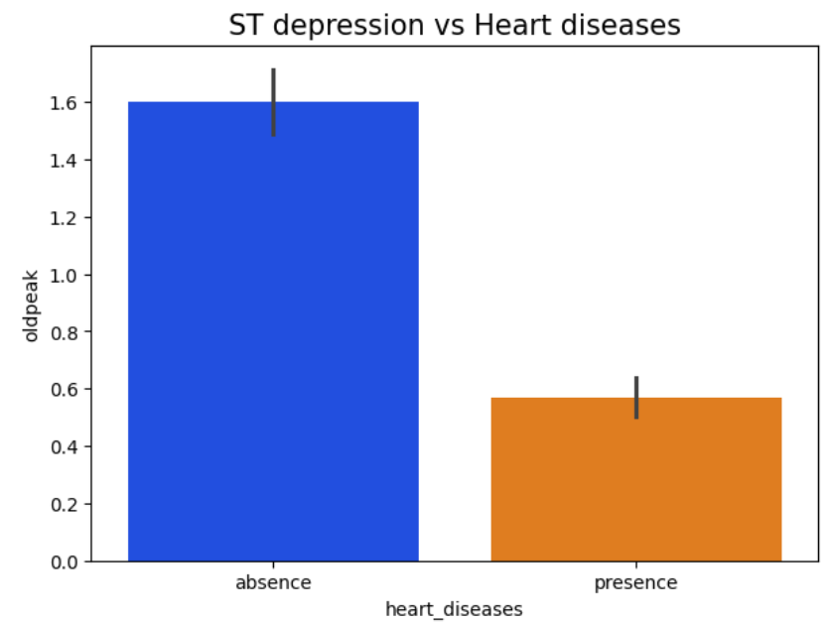
ST depression
Depression level is higher from age group of 30 to 40 and 55 to 70, while from age group 40 to 55 it has been remained stable
Less number of people are suffering from ST depression

Slide 18
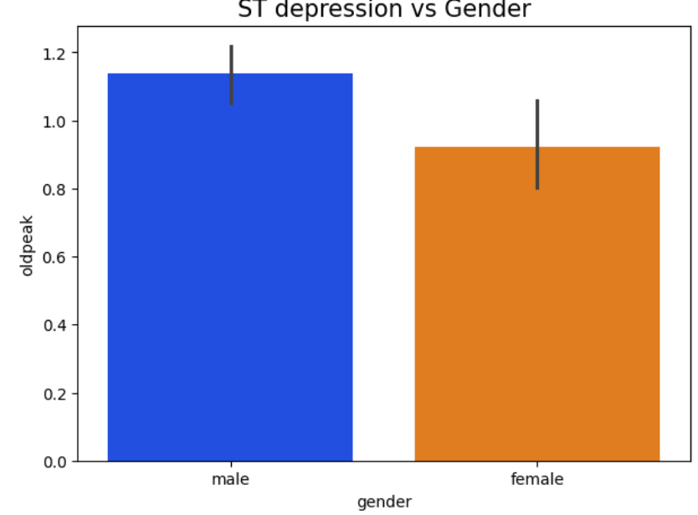
It is been seen that more number of males are likely to develop ST depression than females

Slide 19
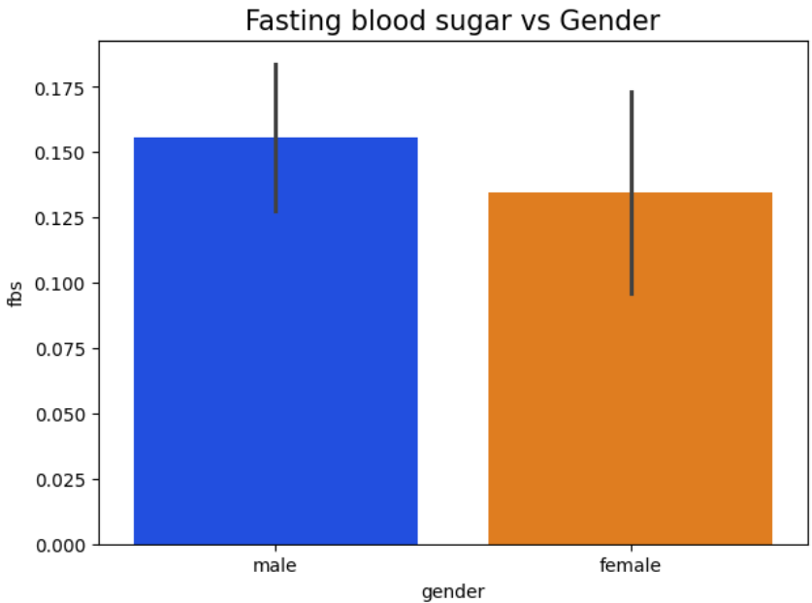
Fasting Blood Sugar
It can be seen that males are having fasting blood sugar>120 mg/dl

Slide 20
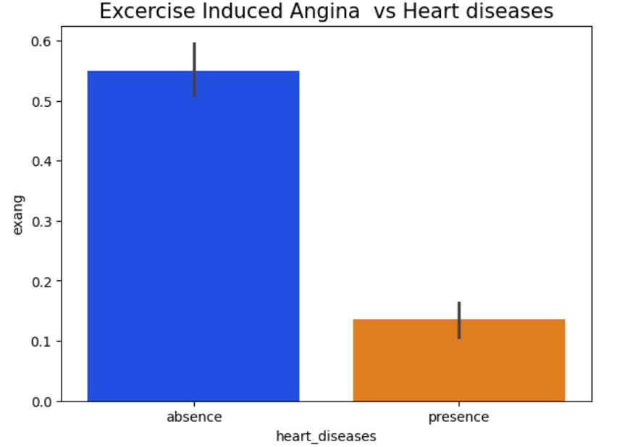
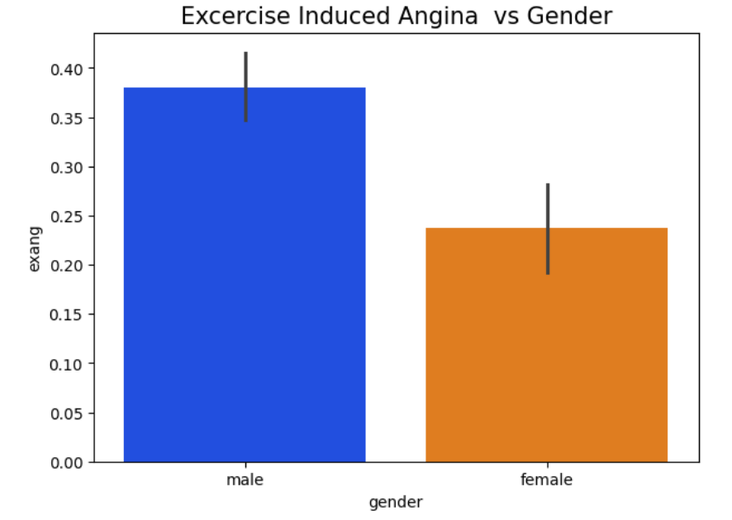
Exercise Induced Angina
It is observed that very less number of people are suffering from exercise induced angina pain
It can be observed that more number of males have exercise induced angina than females

Slide 21
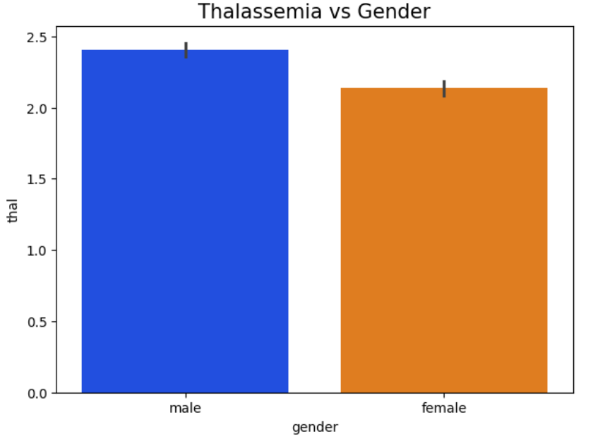
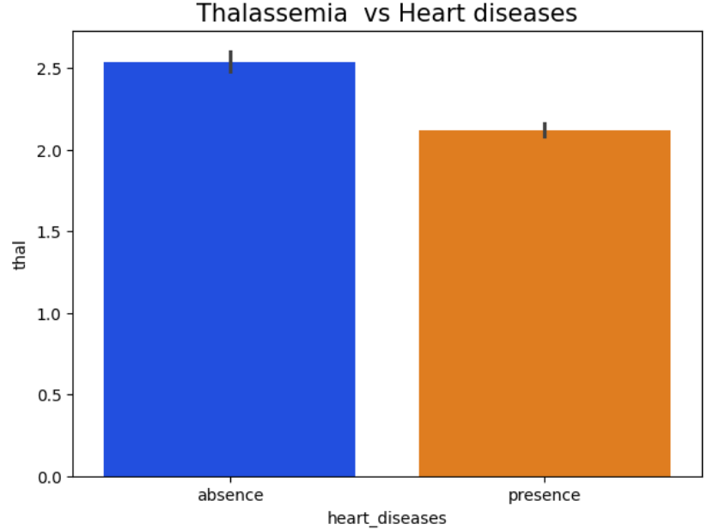
THALASSEMIA
More number of males are affected with moderate to severe thalassemia leading to heart diseases
It can be seen that thalassemia is moderate among people suffering with heart diseases

Slide 22
CONCLUSION
From the overall population, people having heart disease (51%) are greater than those who have heart disease(49%)..
Elder Age People and Middle Age People are mostly affected with Heart Disease.
We can see that Males are mostly tend to have Heart Disease
It seems people having Non-Anginal chest pain have a higher chance of heart disease
Typical Angina Chest pain means neither causing nor exhibiting symptoms of Heart disease.
We can see that a higher number of men are suffering from Typical Angina type of Chest Pain
Males have high number of Fasting Blood Sugar > 120 mg/dl
Blood Pressure Rate is almost equal in Males and Females
Cholesterol levels are higher in females compared to males
Higher Cholestrol Level and Higher Blood Pressure Level causes high chances of Heart Disease
More number of males are likely to develop ST depression and exercise induced angina pain
Higher number of males suffering from heart disease are most likely to develop moderate to severe thalassemia

Slide 23
THANKYOU!!

